Slide 1

Process Mining Virtual Internship
by
G.SUMANTH REDDY
Roll No. 214G1A32A5
Department of Computer Science and Engineering (Data Science)
Srinivasa Ramanujan Institute of Technology
(Affiliated to JNTUA & Approved by AICTE) (Accredited by NAAC with ‘A’ Grade & Accredited by NBA (EEE, ECE & CSE)
Rotarypuram Village, B K Samudram Mandal, Ananthapuramu – 515701.
2023 - 2024

Slide 2

Contents
Course Objective
Introduction
Technology
Applications
Modules
Real Time applications
Learning outcomes
GitHub Link
Queries

Slide 3
Course Objective
From the Celonis Foundation you will learn the theoretical and applied fundamentals for Process Mining .
We will learn how to perform high level tasks with Celonis by building a process model.
Process mining applies data science to discover, validate and improve workflows.

Slide 4
Introduction
What is Celonis ?
Celonis is a software company that specializes in process mining and process optimization.
It was founded in 2011 by Bastian Nominacher, Martin Klenk, and Alexander Rinke in Germany.
Celonis claims to be the world leader in process mining
The Main objectives of Celonis are:
Improve Process Efficiency
Compliance
Overall operational performance

Slide 5
Contd..
What is Process Mining?
Process Mining is the combination of process and mining and it is the data-driven approach that uses event logs and algorithms to analyze, visualize, and improve business processes within an organization.
What is process?
A series of actions which are carried out in order to achieve a particular results.
What is Mining?
Is the process of extracting useful information from huge amount of data.

Slide 6
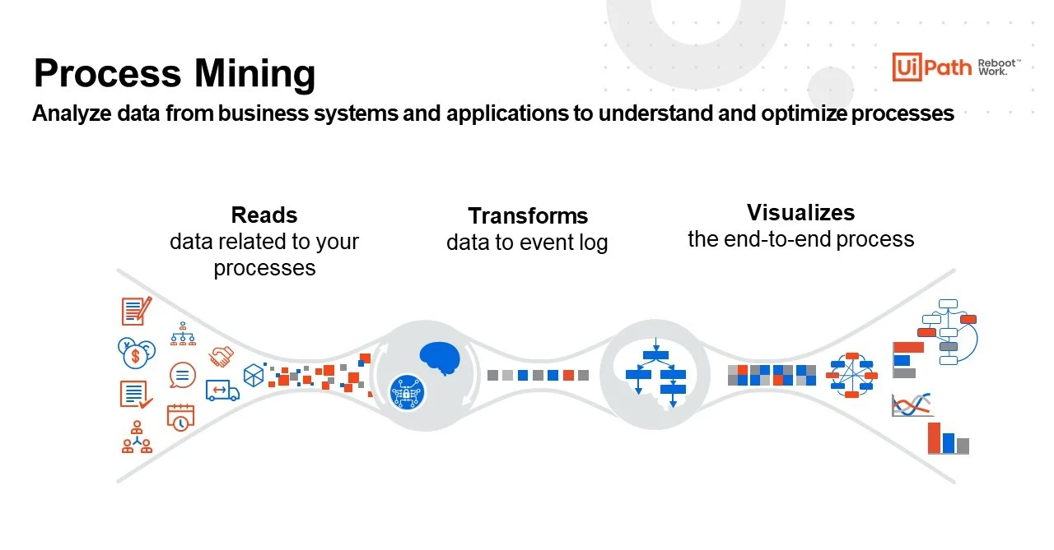
Contd..
How Process Mining Works?

Slide 7
Technology
The technologies followed by process mining are as follows
1.Process Discovery
Process discovery is a crucial step in process mining that involves automatically creating a visual representation of a business process based on event data collected from various IT systems, databases, or applications.
2.Conformance Checking
The purpose of conformance checking is to identify deviations and differences between the data represented by the model and the real-world execution of the process.
3.Operational Support
Operation support aims to maintain the stability, reliability, and effectiveness of an organization's core activities.

Slide 8
Applications
The major applications of process mining are
1.Performance Measurement
2.Predictive Analysis
3.Fraud Detection
1.Performance Measurement:
Performance measurement is used across various sectors and industries, from business and finance.By measuring and analyzing on performance data.
2.Predictive Analytics: Some process mining tools have integrated predictive analytics capabilities. By analyzing historical process data, organizations can make predictions about future process behaviors and potential issues.

Slide 9
Contd..
3.Fraud Detection:
Fraud detection is the process of identifying and preventing fraudulent activities within an organization or system. It involves using various techniques and technologies to analyze data, patterns, and behaviors to detect anomalies or unusual activities.

Slide 10
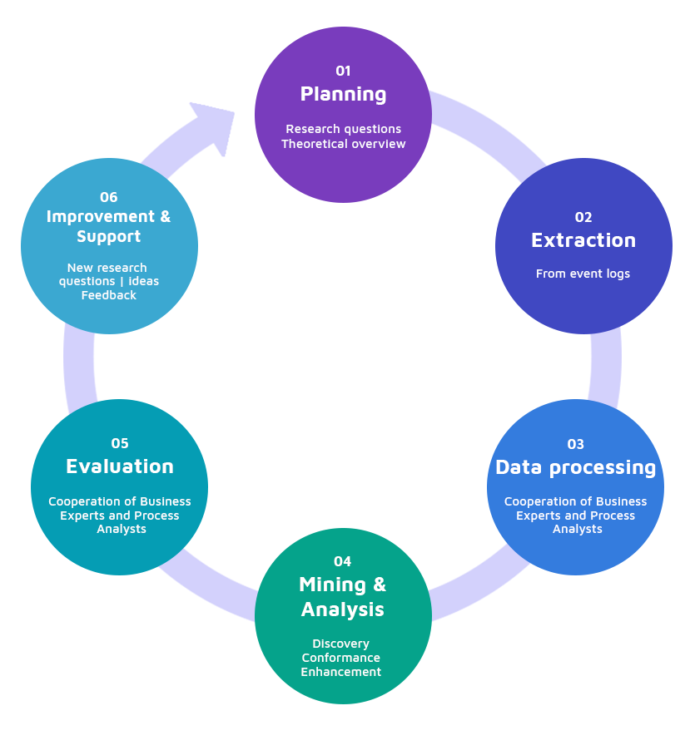
Module
Steps involved in process mining:
1.Planning
2.Extraction
3.Data Processing
4.Mining and Analysis
5.Evaluation
6.Improvement and Support

Slide 11
Contd..
Planning: planning is nothing but it is the process of thinking regarding the activities to achieve a desired goal.
Data Extraction: It is the process of collecting information from various sources like databases,spreadsheets,csvfiles etc.
Data Preprocessing:It is the process of transforming raw data into an understandable format.
Mining and Analysis:Collecting the useful information from huge amout of data and determining its essential features.
Evaluation:It is the process of measuring the quality and accuracy of the data which we collected.
Improvement and support:It is the process of making something better than the previous one.

Slide 12
Module
1. Process Mining Fundamentals :
The key fundamentals of process mining involves extracting insights from event
Data.
Understand how processes function, identifying bottlenecks, inefficiencies, and opportunities for optimization. Key components include data extraction, process discovery, conformance checking, and process Enhancement.
2.Data Integration: Data integration is the process of bringing data from disparate sources together to provide users with a combined view. The premise of data integration is to make data more freely available and easier to consume and process by systems and users. Data integration can reduce IT costs, free-up resources, improve data quality, and foster innovation all without sweeping changes to existing applications or data structures.

Slide 13
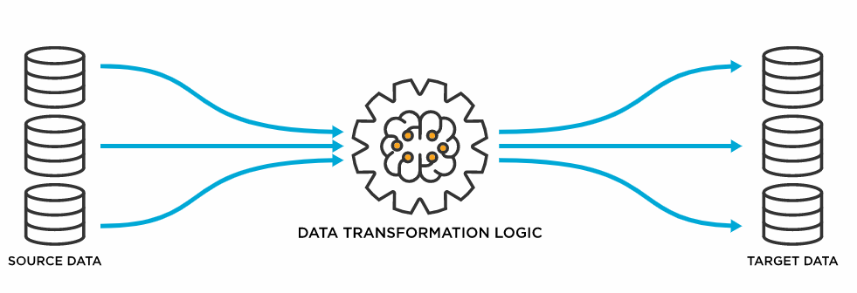
Contd..
3.Data Transformation:
4.Data Loading:Data loading defines the LOAD component of the ETL process. ETL stands for Extraction, Transformation, and Load. Extraction deals with the retrieval and combining of data from multiple sources. Transformation deals with cleaning and formatting of the Extracted Data. Data Loading deals with data getting loaded into a storage system like cloud etc.

Slide 14
Real Time Examples
Some Of The Real Time Examples are:
1. HealthCare Process Analysis:
Healthcare analysis plays a critical role in improving the quality of patient care, optimizing operational efficiency, making informed decisions, and driving evidence-based practices in the healthcare industry.
2. E-Commerce Order Fulfillment:
Analyzing the end-to-end process of handling customer orders, from order placement to shipment.
3.Financial Transaction Processing:
Analyzing the process of handling financial transactions, including validation, authorization, and settlement. Process mining improves transaction security.

Slide 15
Contd..
4.Insurance Claims Processing:
Tracking the steps involved in processing insurance claims, including documentation, assessment, and payment. Process mining can help identify areas for automation.
5. Public Transportation:
Analyzing data from GPS trackers and passenger ticketing systems to optimize bus routes, reduce overcrowding, and improve overall public transportation efficiency.
6. Academic Institutions:
Tracking the steps involved in enrolling students, including application submission, documentation review, and course registration. Process mining can help optimize the enrollment process and reduce administrative load.

Slide 16
Outcomes
Process mining can lead to several valuable outcomes that contribute to improving business processes, enhancing efficiency, and making data-driven decisions.
Put your knowledge about the theoretical foundations of Process Mining into practice
Conceptualize your process in terms of activities and cases.

Slide 17
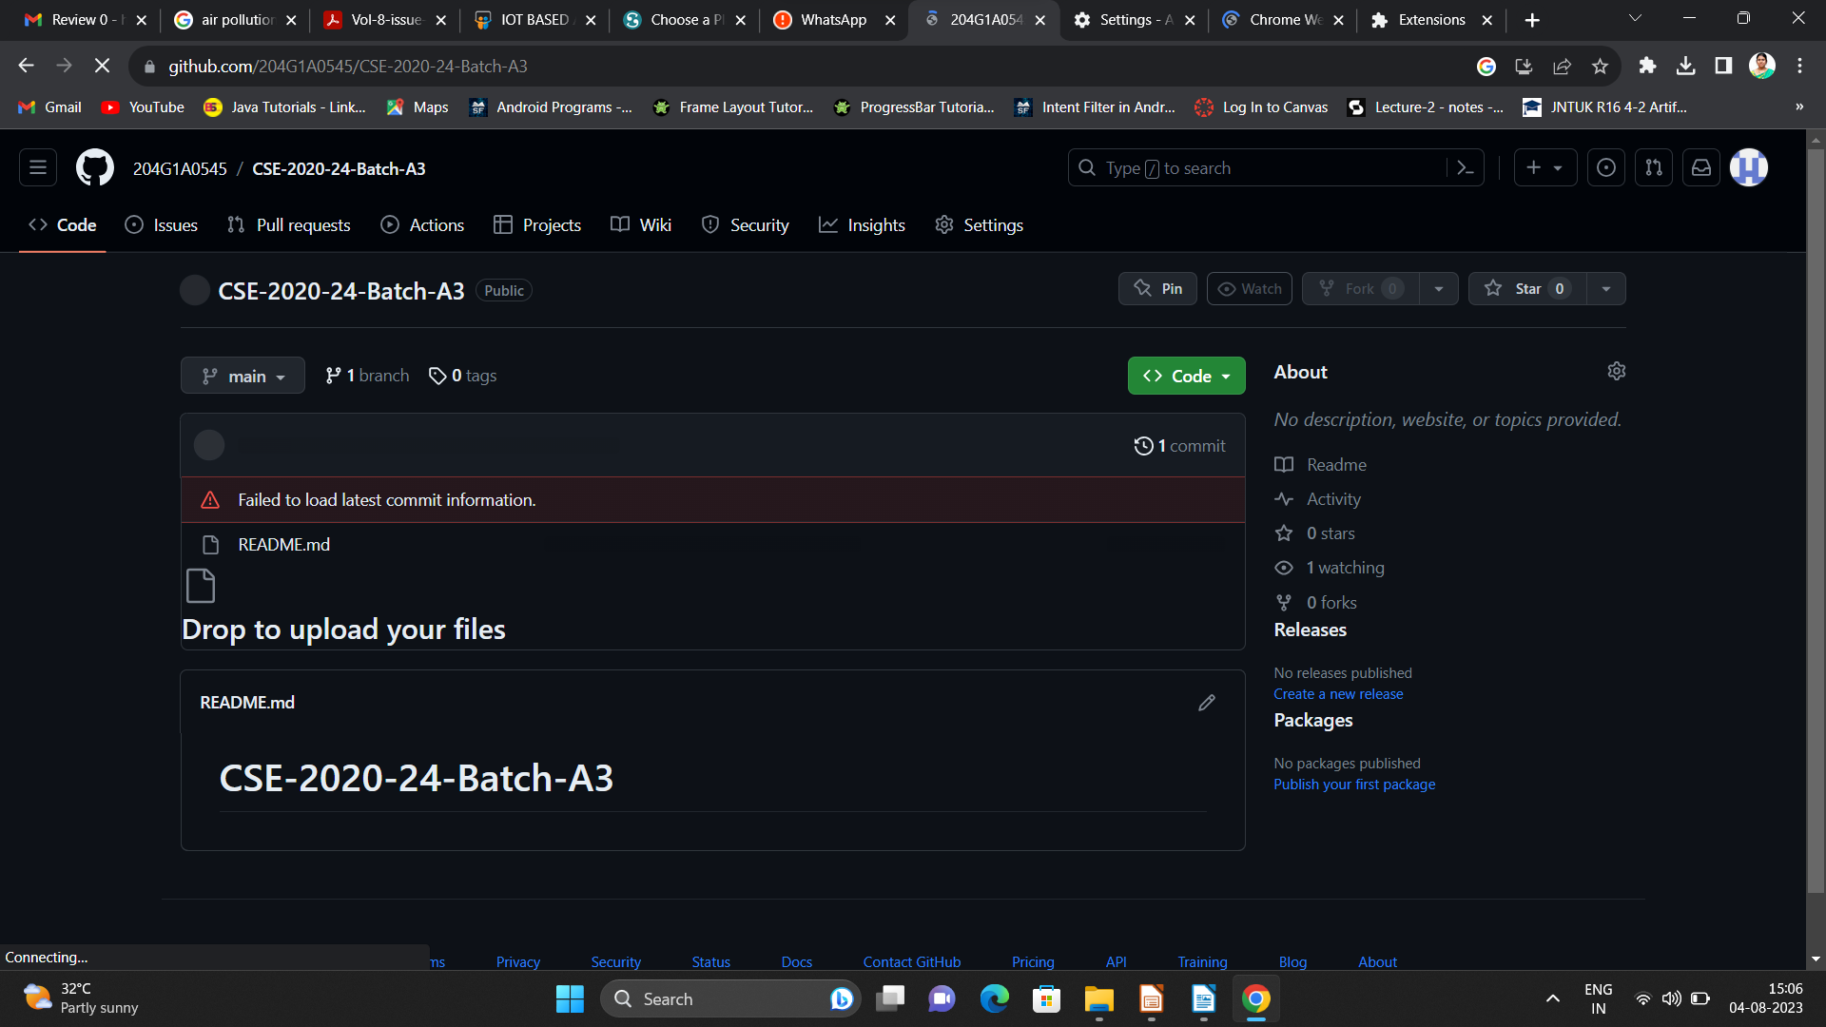

Git Hub Dashboard
Repository Name Like: Summer Internship - I
Under that include document, presentation and Certificate(Pdf).

Slide 18
Any Queries?

Slide 19
Thank You!!!

